Slide 1
Welcome to the Causal Statistics for Treatment Models TD

Slide 2
Who are you? Why have you picked this course & TD?

Slide 3

What are the goals of this TD?
I want to help you to build your own behavioural science research project!
1) How to conduct a R Markdown project relying on best practices?
2) How to craft a quick and relevant behavioural science project?
3) How to apply econometrics concepts in your own research project?
More generally, this is a time slot to discuss relevant questions and uncertainties related to the “causal statistics for treatment models” course.

Slide 4
What is the programme?
Part 1: Creating a R Markdown project using regression models.
Part 2: Creating a R Markdown project using econometrics concepts.
S1 (06/02/2025): Introduction & prerequisites
S6 (27/03/2025): Research question & data cleaning
S2 (13/02/2025): Research question & data cleaning
S7 (03/04/2025): Statistical models & robustness checks
S3 (20/02/2025): Statistical models & robustness checks
S8 (10/04/2025): Supplementary analyses & production of a report
S4 (13/03/2025): Supplementary analyses & production of a report
S9 (17/04/2025): Presentation of the projects & discussions
S5 (20/03/2025): Presentation of the projects & discussions

Slide 5
What is the content of a session?
A typical session
(~20 minutes)
(Me) Presentation of key considerations
(Me) Presentation of a toy R project
(~80 minutes – including 10 minutes break)
(You) Work on your research project
(Me) Support on your research project
(20 minutes)
(Us) Discussion on what everyone did and/or failed to do during the session

Slide 6
What is the dataset used for the first part of the TD?

Slide 7

Dataset for the part 1 of the TD
You can also choose another dataset including economics and psychology variables (but I may not be able to help you as much on the content)!

Slide 8
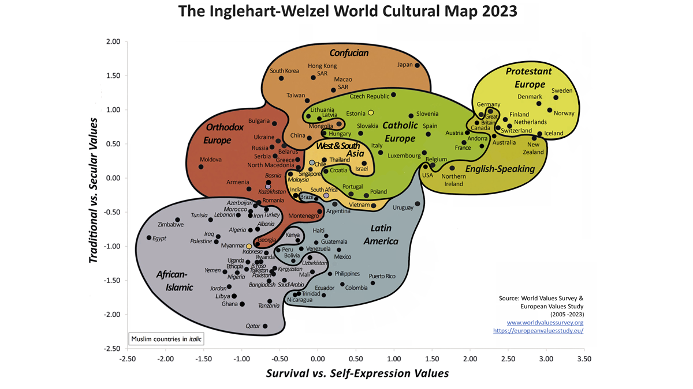
More details on the Integrated Values Survey (IVS)
Notes:
https://www.worldvaluessurvey.org/WVSContents.jsp

Slide 9
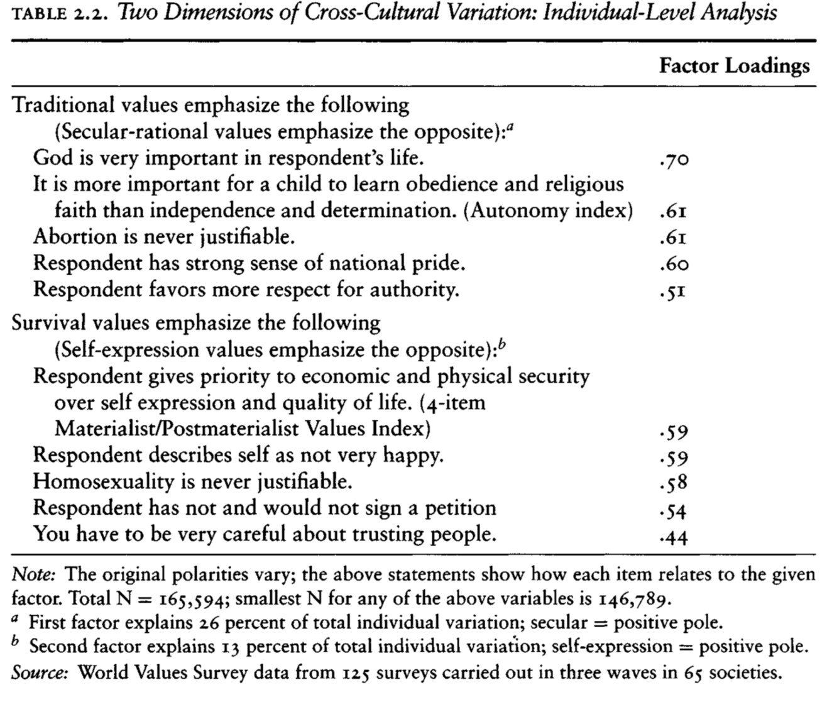
More details on the Integrated Values Survey (IVS)
Notes:
https://www.worldvaluessurvey.org/WVSContents.jsp

Slide 10

More details on the Integrated Values Survey (IVS)
Notes:
https://kulturiskvlevebi.weebly.com/uploads/1/8/3/7/18376403/ronald_f._inglehart_-_cultural_evolution__people%E2%80%99s_motivations_are_changing_and_reshaping_the_world__2018_cambridge_university_press_-compressed.pdf

Slide 11
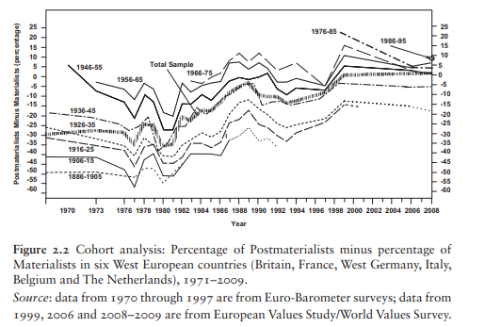
More details on the Integrated Values Survey (IVS)
Notes:
https://kulturiskvlevebi.weebly.com/uploads/1/8/3/7/18376403/ronald_f._inglehart_-_cultural_evolution__people%E2%80%99s_motivations_are_changing_and_reshaping_the_world__2018_cambridge_university_press_-compressed.pdf

Slide 12
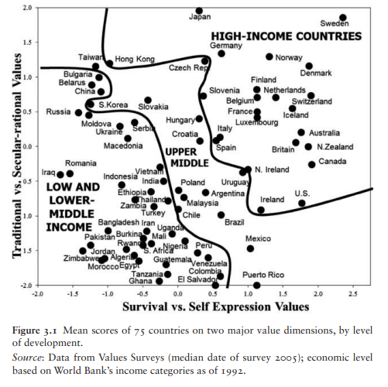
More details on the Integrated Values Survey (IVS)
Notes:
https://kulturiskvlevebi.weebly.com/uploads/1/8/3/7/18376403/ronald_f._inglehart_-_cultural_evolution__people%E2%80%99s_motivations_are_changing_and_reshaping_the_world__2018_cambridge_university_press_-compressed.pdf

Slide 13
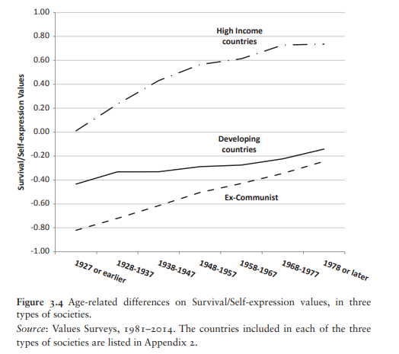
More details on the Integrated Values Survey (IVS)
Notes:
https://kulturiskvlevebi.weebly.com/uploads/1/8/3/7/18376403/ronald_f._inglehart_-_cultural_evolution__people%E2%80%99s_motivations_are_changing_and_reshaping_the_world__2018_cambridge_university_press_-compressed.pdf

Slide 14
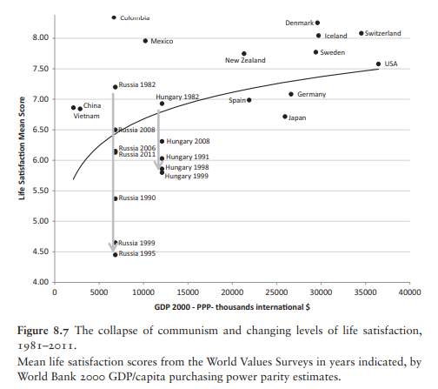
More details on the Integrated Values Survey (IVS)
Notes:
https://kulturiskvlevebi.weebly.com/uploads/1/8/3/7/18376403/ronald_f._inglehart_-_cultural_evolution__people%E2%80%99s_motivations_are_changing_and_reshaping_the_world__2018_cambridge_university_press_-compressed.pdf

Slide 15
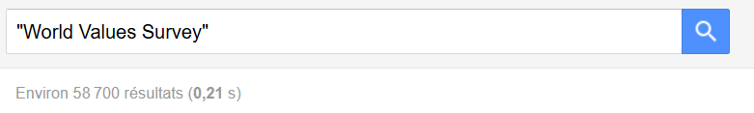
More details on the Integrated Values Survey (IVS)

Slide 16
Do you have any questions or suggestions regarding this TD, or course more generally?

Slide 17
Let’s download everything needed to analyse the data!

Slide 18
What is your level in R?

Slide 19
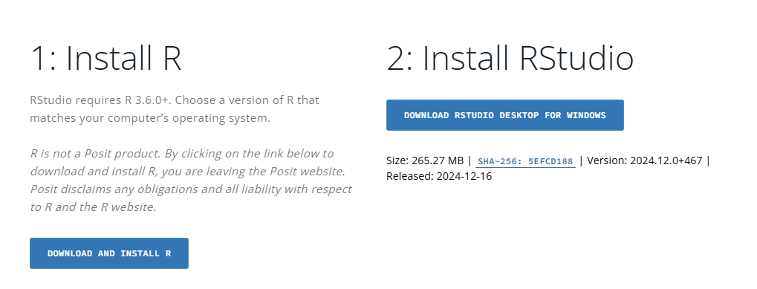
R & RStudio
Who needs to install R?
https://posit.co/download/rstudio-desktop/

Slide 20
Who doesn’t want to use the IVS dataset?

Slide 21
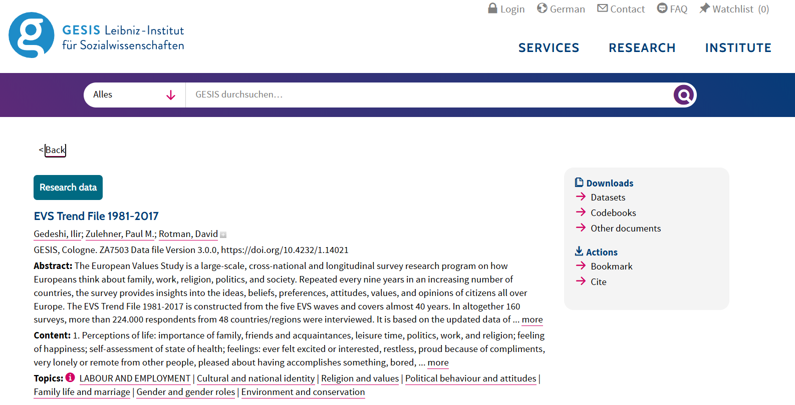
Downloading the dataset
Create an account on GESIS
https://search.gesis.org/research_data/ZA7503

Slide 22
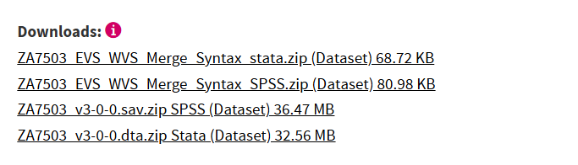
Downloading the dataset
Put the dataset in the folder where you will create your Rmd file!

Slide 23
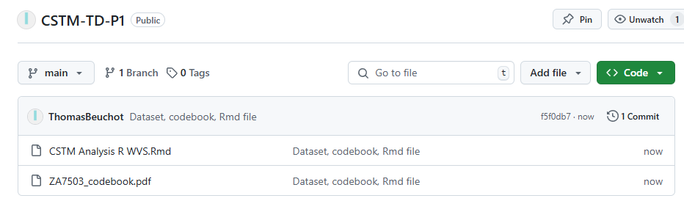
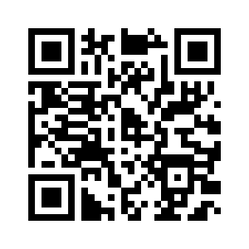
Additional files on my GitHub
https://github.com/ThomasBeuchot/CSTM-TD-P1

Slide 24
Q&A: What else do you need to know?

Slide 25
Let’s begin looking at the variables in the dataset and crafting a research question!

Slide 26
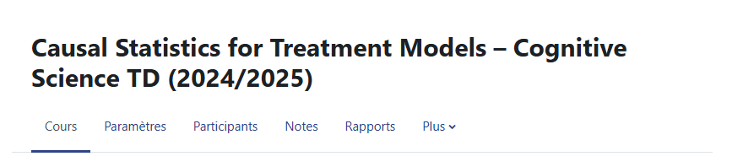
Moodle page of the TD
Is everyone registered on the Moodle page?
Notes:
https://moodle.psl.eu/course/view.php?id=25343

Slide 27
Let’s wrap-up!
Do you have ideas on a research question you would like to explore?
Do you have questions or uncertainties?

